Slide 1
Data Structure Lab 02 Review on C++ concepts and OOP part II

Slide 2
Agenda
Function template
Generic class
Inheritance
Function overriding
Abstract class(Interface)
Why OOP

Slide 3
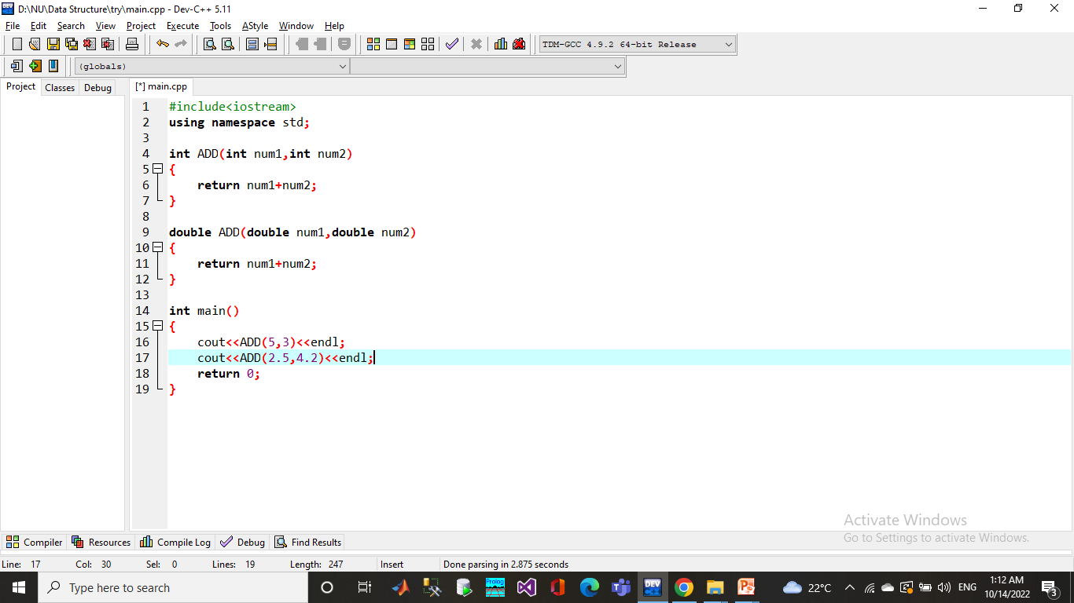
Function Overloading
Functions with same name and different parameters
Overloaded functions should perform similar tasks

Slide 4
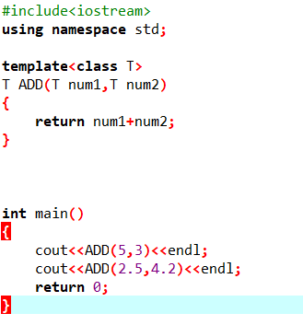
Function template
The simple idea is to pass data type as a parameter so that we don’t need to write the same code for different data types.

Slide 5
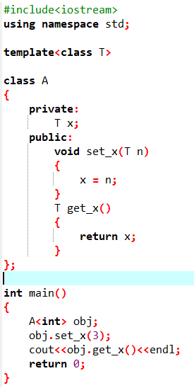
Generic class
Like function templates, class templates are useful when a class defines something that is independent of data type.

Slide 6
Inheritance
The capability of a class to derive properties and characteristics from another class is called Inheritance.
The old class is known as “base” class, “super” class or “parent” class”; and the new class is known as “sub” class, “derived” class, or “child” class.

Slide 7
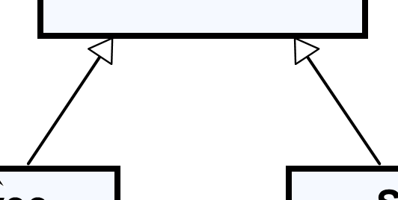
Inheritance - UML Representation
This is a Generalization relationship
“IS-A”
Superclass
(Base Class)
Person
+Name: String
+Address: String
Subclass
(Derived Class)
Subclass
(Derived Class)
Employee
Student
+Company: String
+Salary: double
+School: String
Notes:
Generalization expresses a parent/child relationship among all classes

Slide 8
Inheritance
Access specifier meaning:
● Base class's private members can not be accessed in a derived class.
● Base class's protected members can be accessed in a derived class.
● Base class's public members can be accessed from anywhere
Notes:
Protected access modifier is similar to that of private access modifiers, the difference is that the class member declared as Protected are inaccessible outside the class but they can be accessed by any subclass(derived class) of that class.

Slide 9
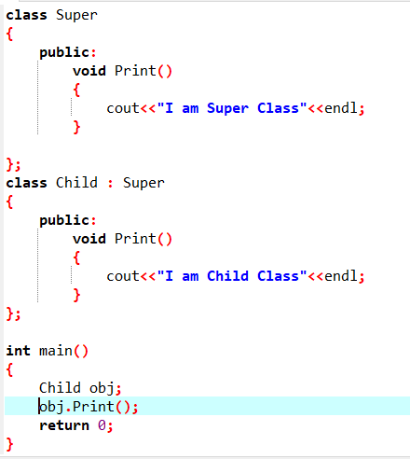
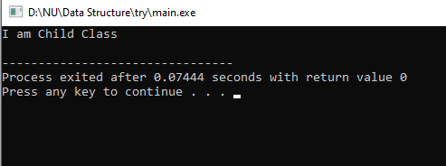
Function Overriding
It is the redefinition of base class function in its derived class with same signature (i.e., return type and parameters).
It can only be done in derived class.

Slide 10
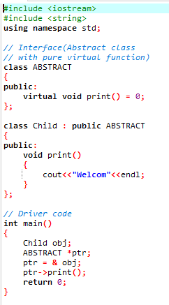
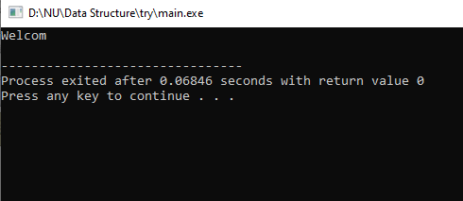
Abstract class(Interface)
Interfaces are nothing but a way to describe the behavior of a class without committing to the implementation of the class

Slide 11
Why OOP?
Simplify programming
Interfaces
Information hiding:
Implementation details hidden within classes themselves
Software reusability
Class objects included as members of other classes
Inheritance

Slide 12
Summary of OOP
Object-Oriented Programming (OOP) Concepts
Encapsulation
Polymorphism
Inheritance
Information
hiding
Function
overriding
Different ways to inherit classes from other classes
Classes and objects
Constructor
and destructor
Function
overloading
Function
overriding
Access specifier
Getter and setter

Slide 13
Let us practice
Create class called Person that has:
ID number and name
Create a parameterized constructor to initialize the attributes’ values
Create class called Emp class that inherits Person class, and has:
A salary of type float
A parameterized constructor to initialize the 3 attributes
Reuse the parent’s constructor.
Create method display to print the employee’s information.
In main:
Create an object from Emp
Display his information

Slide 14
Task 1
Note that:
The classes Dog and Cat inherit the Animal class
Your program should have 3 classes.
An Animal class that has:
A protected string color with default value = “default color”.
A display_color () method that displays the color.
A Dog class that has method update_dog_color() that updates the color value to “Brown”.
A Cat class that has method update_cat_color() that updates the color value to “White”.
In main:
Create an object from Cat and Dog.
Update their colors and display them.

